Slide 1
salaryball
Baseball player valuations have changed
Are their salaries following suit?

Slide 2
Alex’s Background

Slide 3
Anthony’s Background
Currently working in Education
Bachelor’s degree in Communications and Marketing
Data science is fascinating to me because it has the capacity to change just about everything it touches, it has the power to steer organizational decisions and change the way entire systems function

Slide 4
Project Background
Oakland A’s and the introduction of Analytics
A deep dive into the statistics of baseball
How has the game changed?
How have teams strategized differently?
Can we quantify that change by analyzing player salaries?

Slide 5
Methods
Used data from 2 main sources:
Lahman’s Baseball Database & Baseball Reference’s WAR data
Lahman’s Database
Compiled by Sean Lahman, an award-winning reporter & sports statistician
The preeminent data source for baseball analysis
Consists of 24 different datasets on various baseball-related topics
We used: Batting, Pitching, Fielding, Salaries, People, & Teams

Slide 6
Methods
Datasets contained over 100,000 entries
Each entry represents one player’s performance for one season
Salary data only for 1985-2016
Subset data to create two different data frames for 1995-1999 & 2015-2019
Pre-sabermetric revolution and post-sabermetric revolution

Slide 7
Methods
BattingA: 6,363 entries
BattingB: 7,566 entries
warBatA: 3,070 entries
warPitchB: 4,294 entries

Slide 8
Methods
Baseball Reference Batting/Pitching WAR datasets
Compiled by Baseball Reference, an online encyclopedia which provides detailed statistics throughout the history of organized baseball
Consists of 2 separate datasets, one for batting metrics, one for pitching metrics
Contains new, advanced metrics such as Wins Above Replacement, OPS+, ERA+

Slide 9
Methods
Datasets contained over 100,000 entries
Each entry represents one player’s performance for one season
Subset data to create two different data frames for 1995-1999 & 2015-2019
warBatA, warBatB, warPitchA, & warPitchB
warBatA: 6,357 entries
warBatB: 7,253 entries
warPitchA: 3,067 entries
warPitchB: 4,293 entries

Slide 10
Methods
Used R to subset, wrangle, and join datasets
Recoded variables to be consistent within datasets
Recoded variables to be categorical (for random forests)
Dropped unnecessary variables
Subset all datasets to only contain data for 1995-1999 & 2015-2019
Created new datasets to run analyses on specific portions of the population (4+ WAR, specific ages etc.)
Joined Batting/warBat, Pitching/warPitch, Batting/Salaries, & Pitching/Salaries

Slide 11
Methods
Ran linear regression & ANOVAs in R
For important variables such as salary, WAR, age, plate appearances, innings pitched, etc.
Ran random forests and created correlation matrices in Python
Created visualizations in Tableau

Slide 12
Results

Slide 13
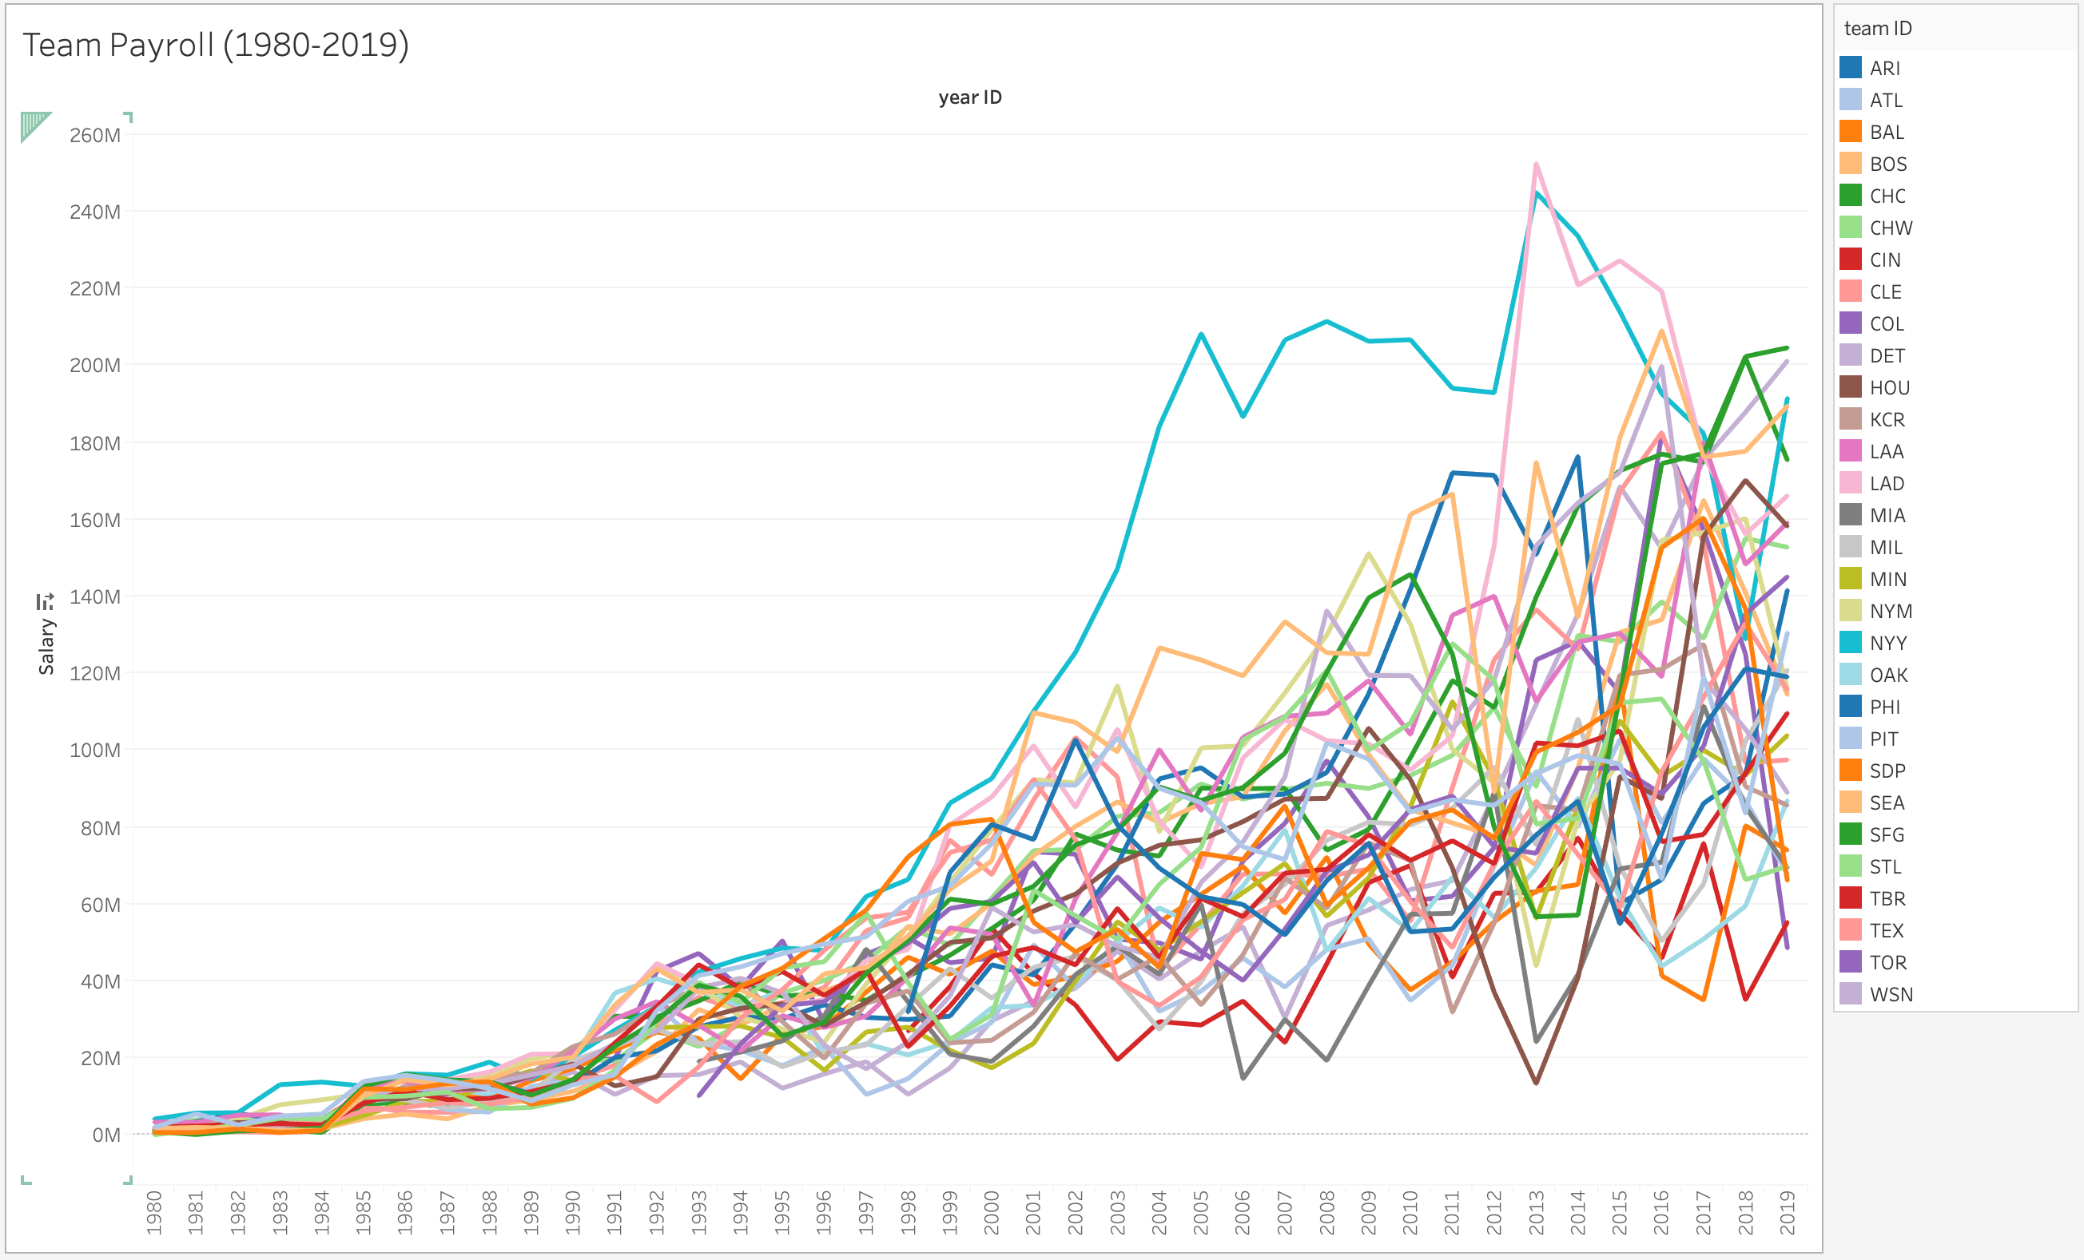
Notice drastic increase starting approximately 1990

Slide 14
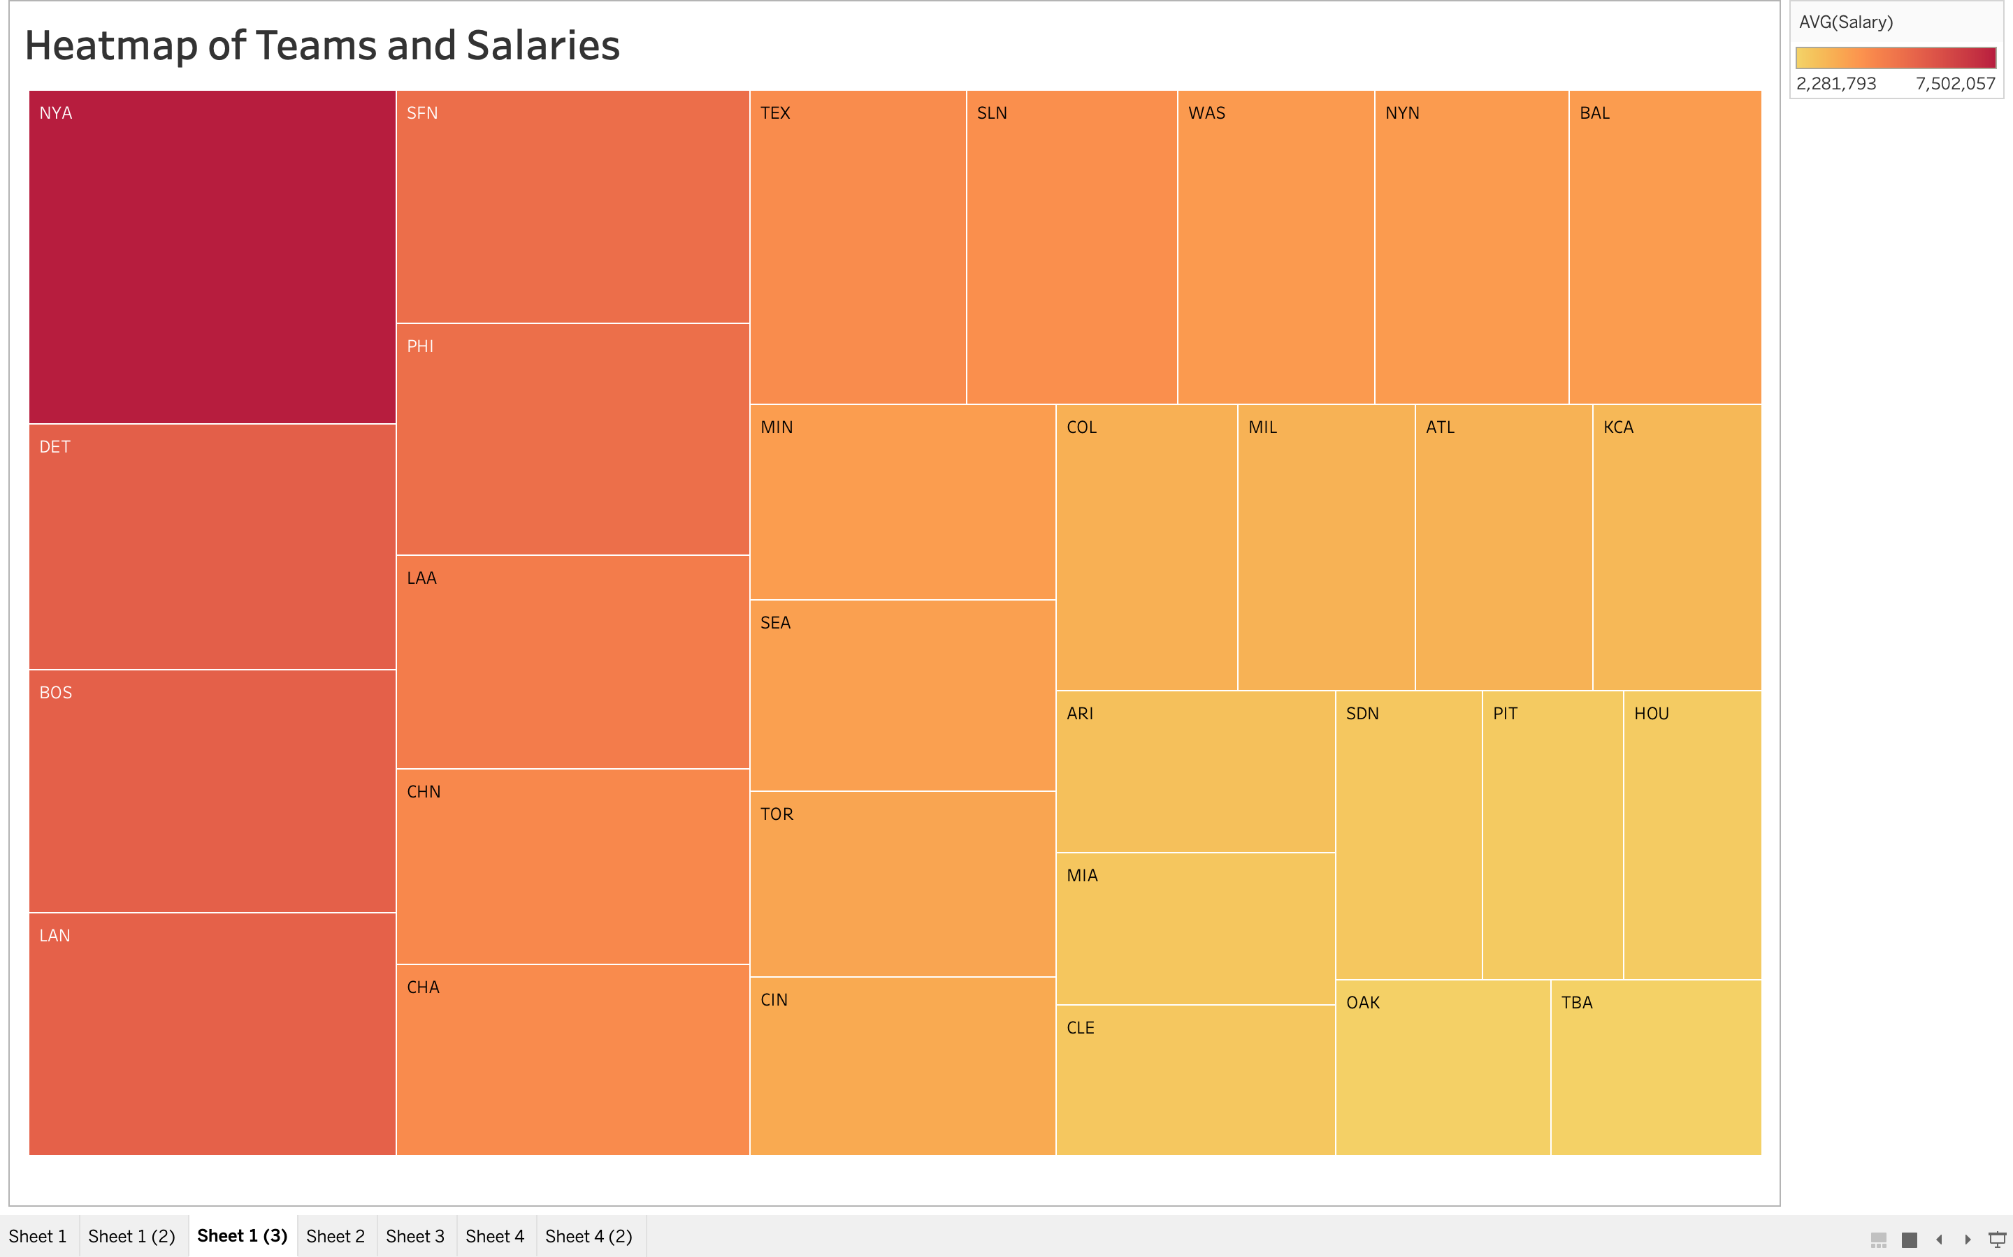
The Yankees spend more than any other team

Slide 15
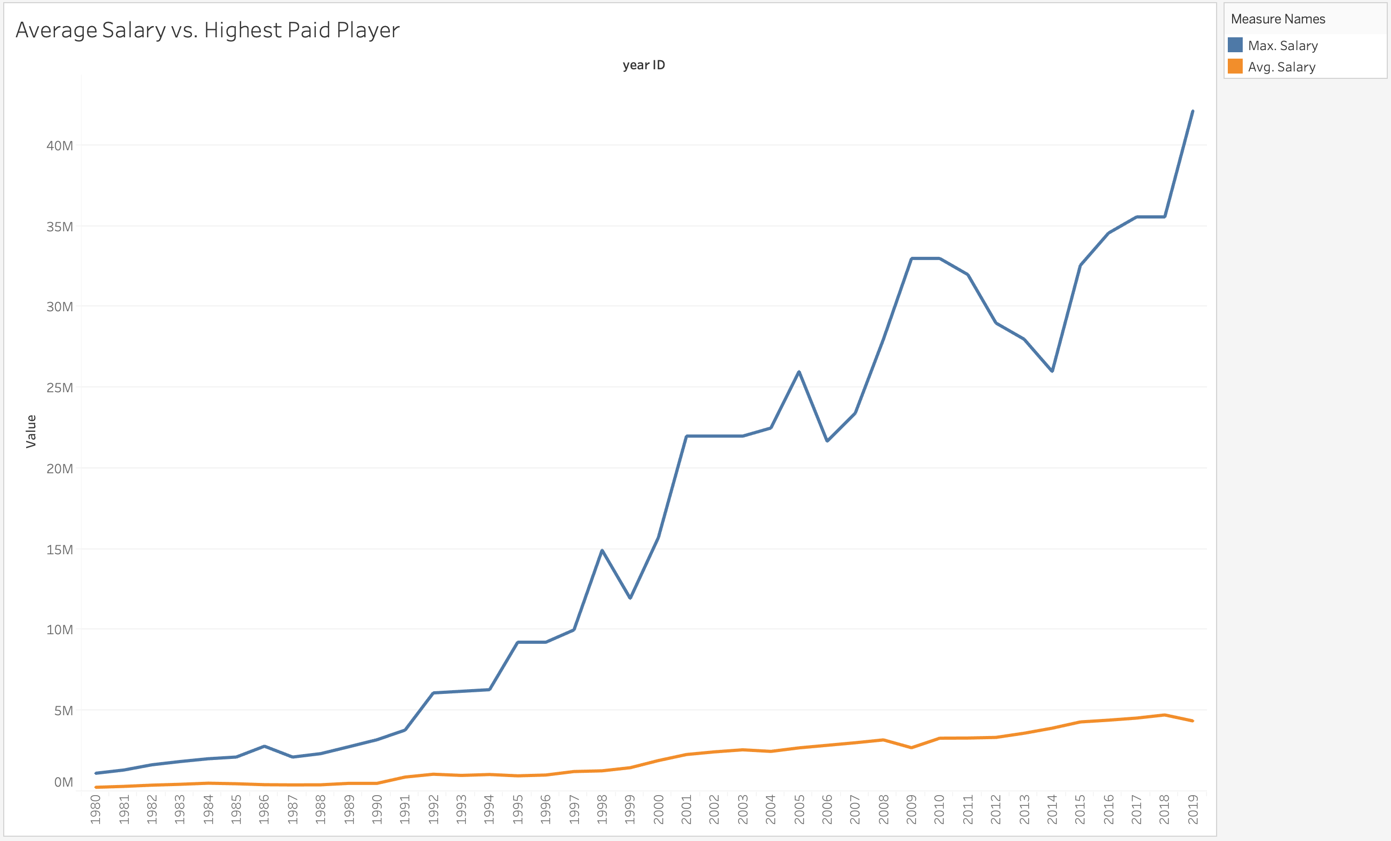
Same phenomenon visible here, as drastic uptick begins ~1990

Slide 16
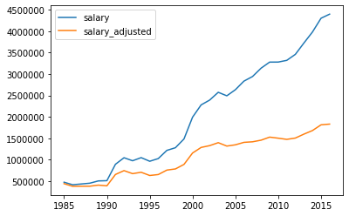
Player Salaries are increasing over time at a rate much higher than inflation can explain by itself
There is a significant difference year to year in salaries both in the 90s and the modern era
1995-2000
P-value = 1.1e-12
2015-2019
P-value = 3.383-09
Average Salary vs. Inflation-Adjusted Average Salary

Slide 17
NEEDS TO BE BULLET-POINTED
Nothing Influences Salary as much as factors of time. Factors such as a players age, plate attempts, and amount of innings played the more the better when influencing a players salary for the better. As a player increases their opportunities for play they at the same time increase their likelihood for higher pay.
After running a repeated measures ANOVA we found that age had a significant impact on salary. Therefore as a player ages their salary changes also and these two factors go hand in hand throughout a players career.
The odd thing about this was that a players performance on the field didn’t seem to automatically mean a player was going to be paid more.

Slide 18
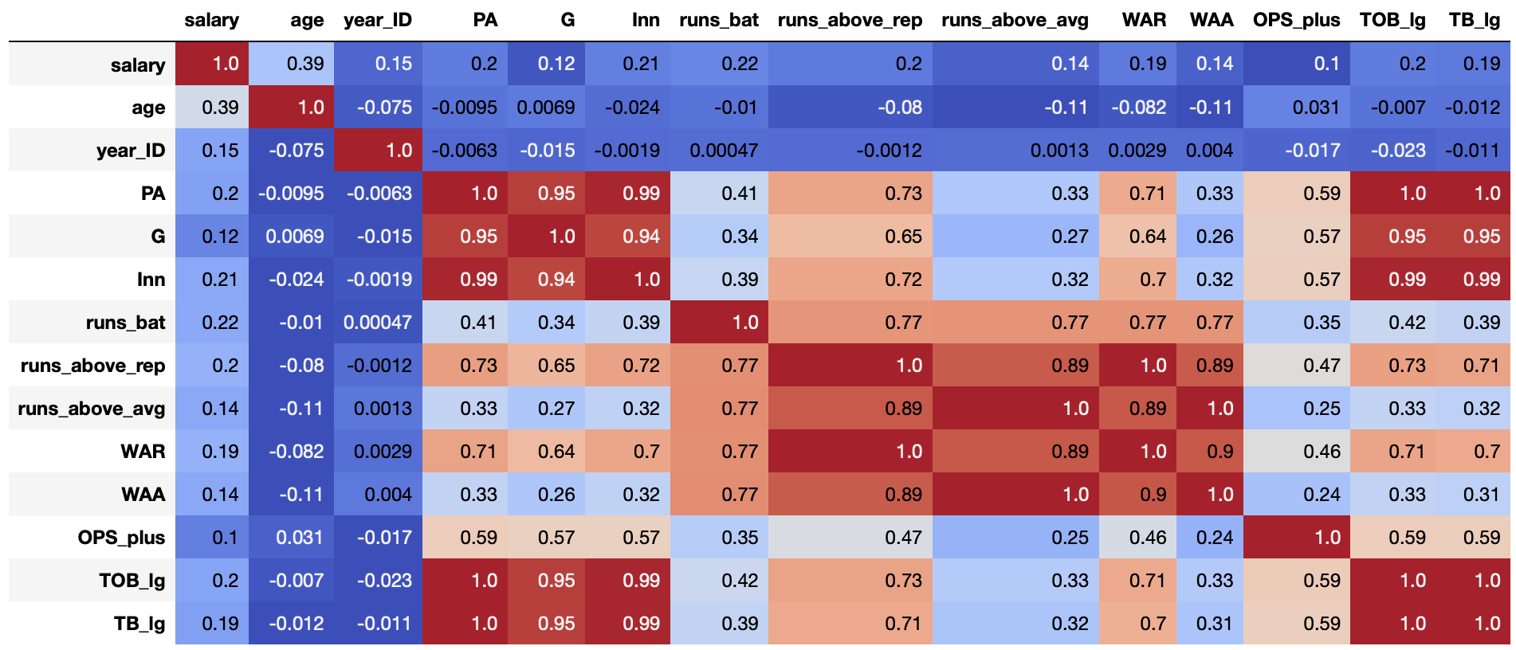
Clear lack of correlating variables for salary

Slide 19
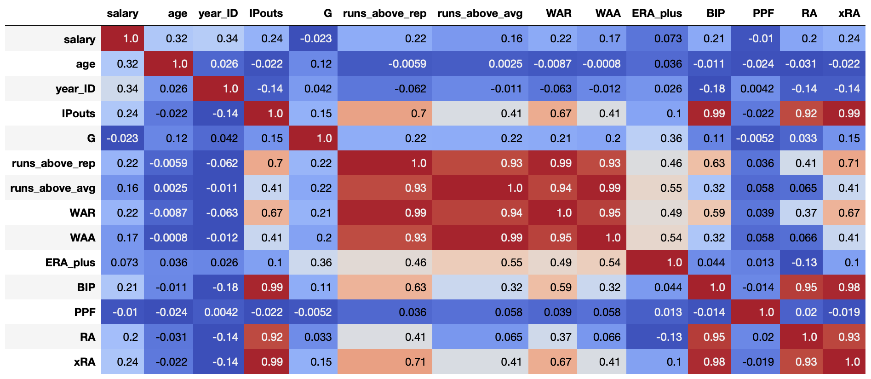
Year far more correlated in pitchers vs. position players

Slide 20
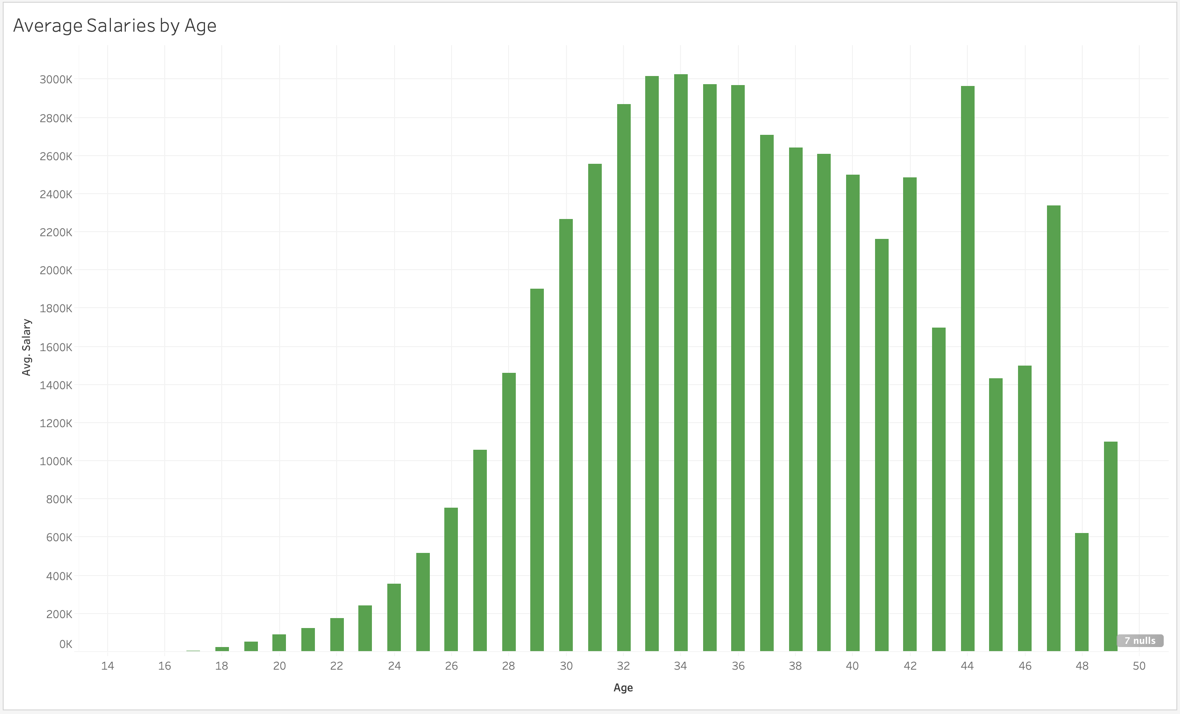

Slide 21
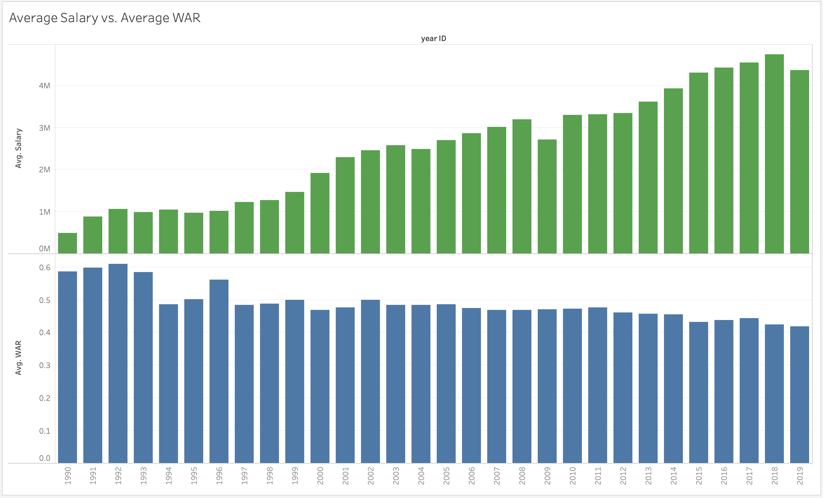

Slide 22
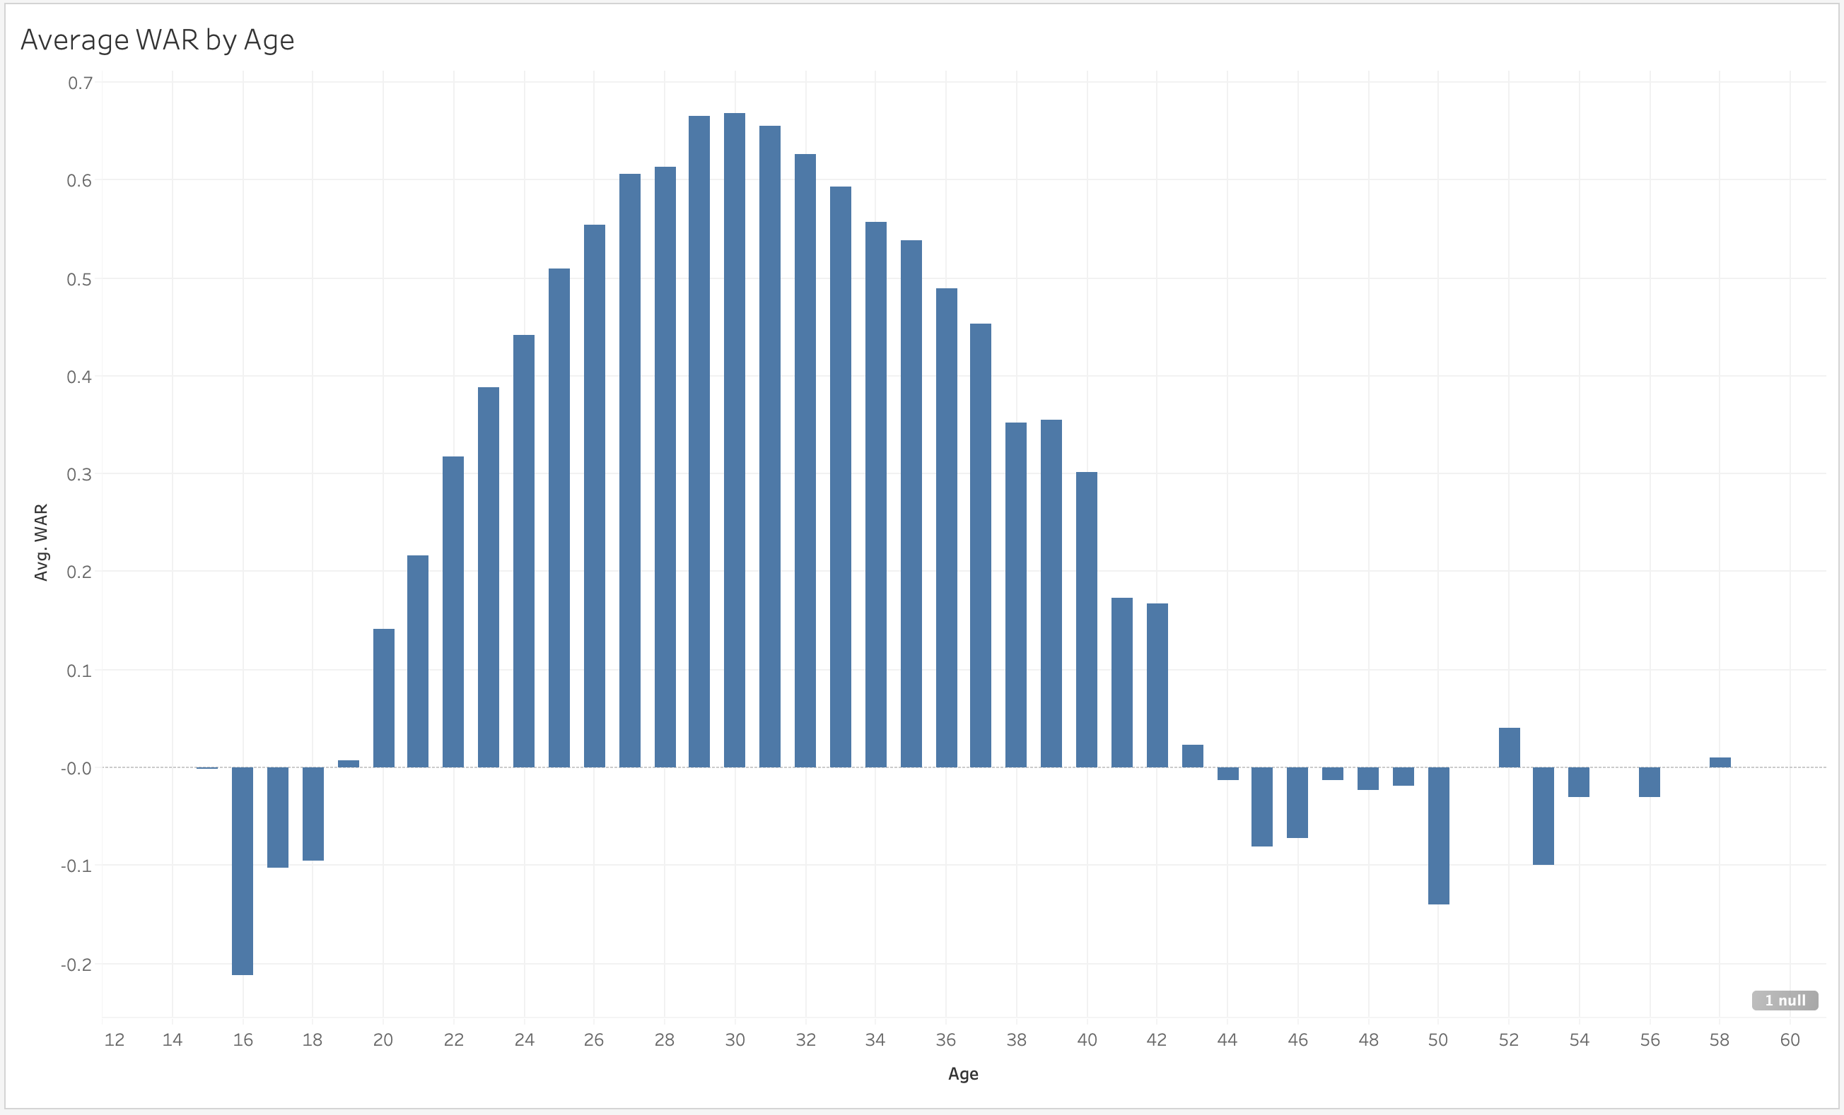

Slide 23
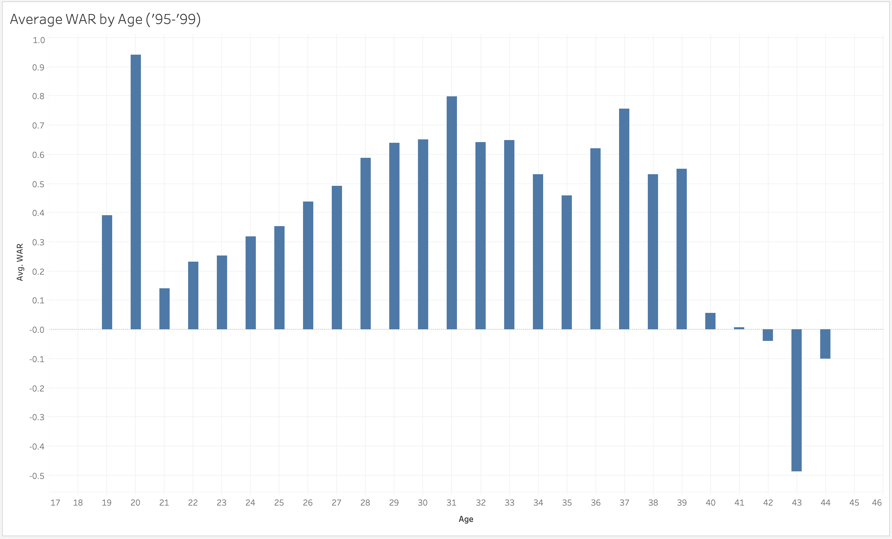
Higher WAR for players in late 20s, 30s

Slide 24
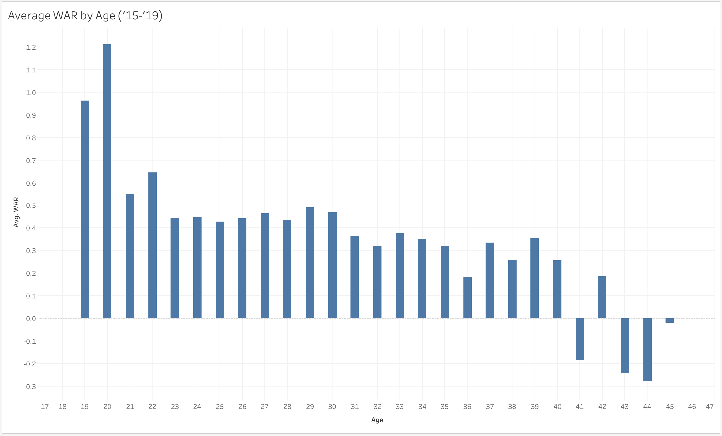
WAR higher in early 20s & lower in 30s

Slide 25
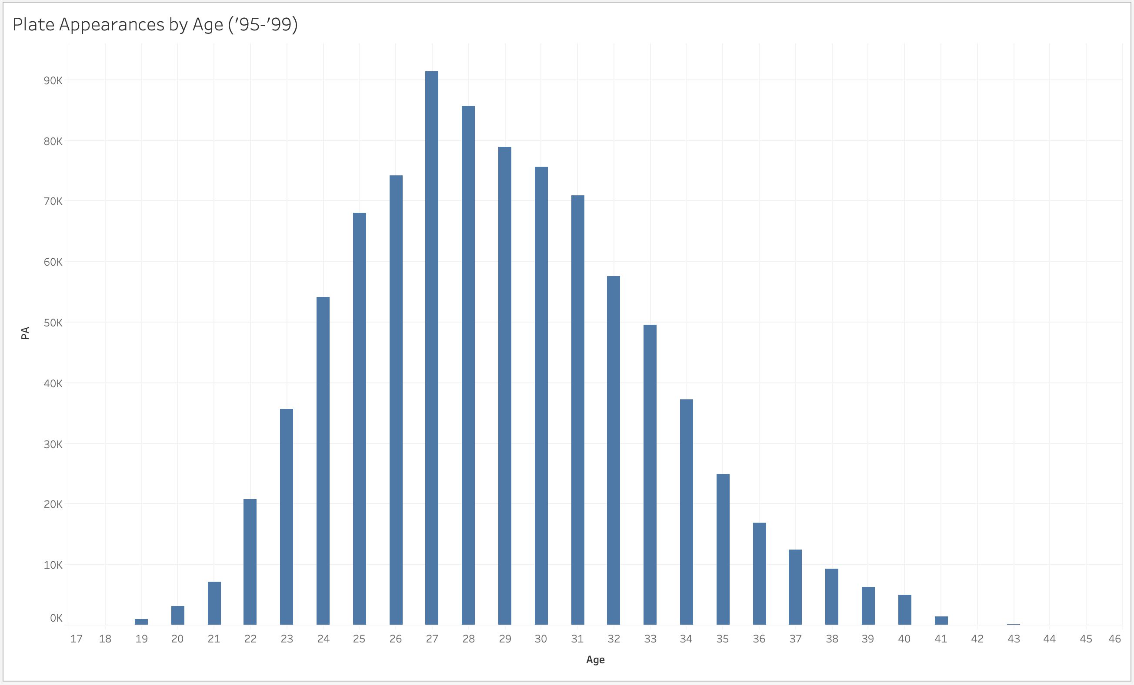
Higher PAs for players in late 20s, 30s

Slide 26
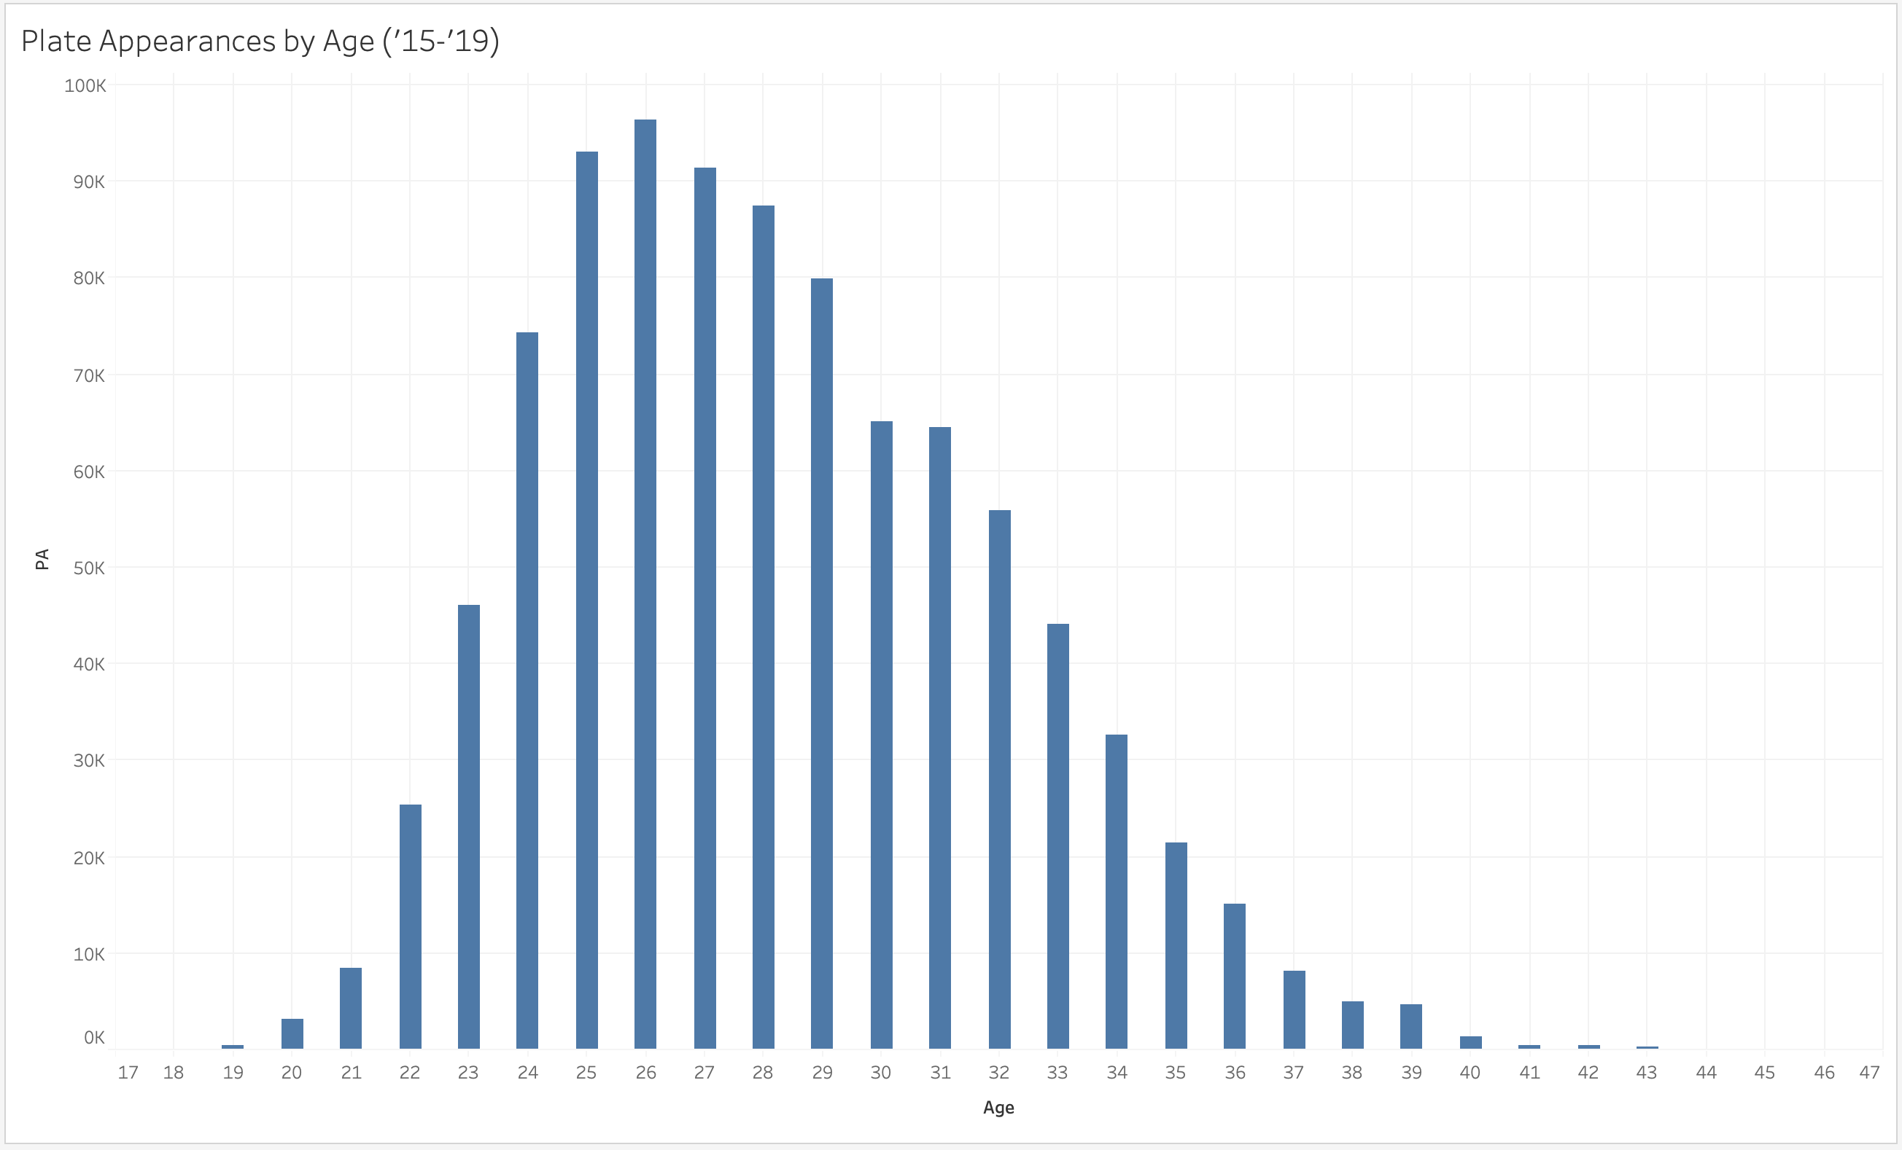
PAs make clear shift towards early 20s

Slide 27
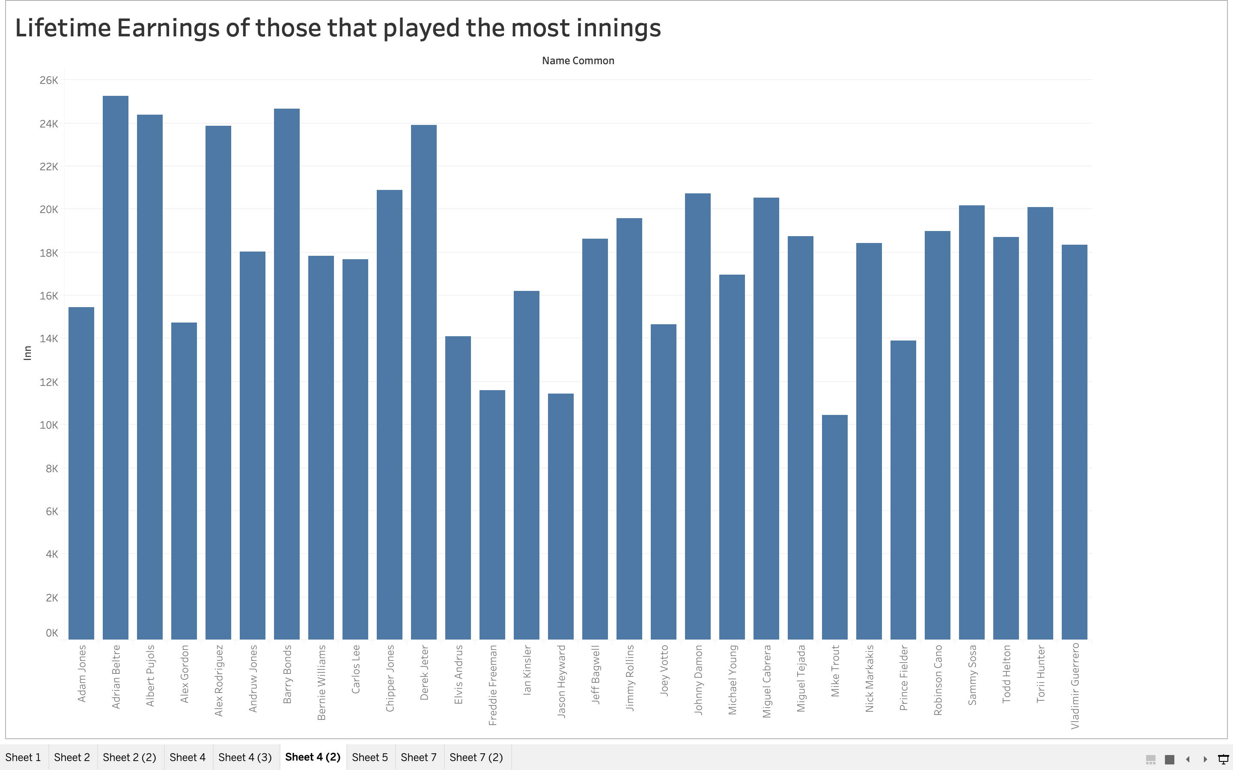
I preferred the line chart?

Slide 28
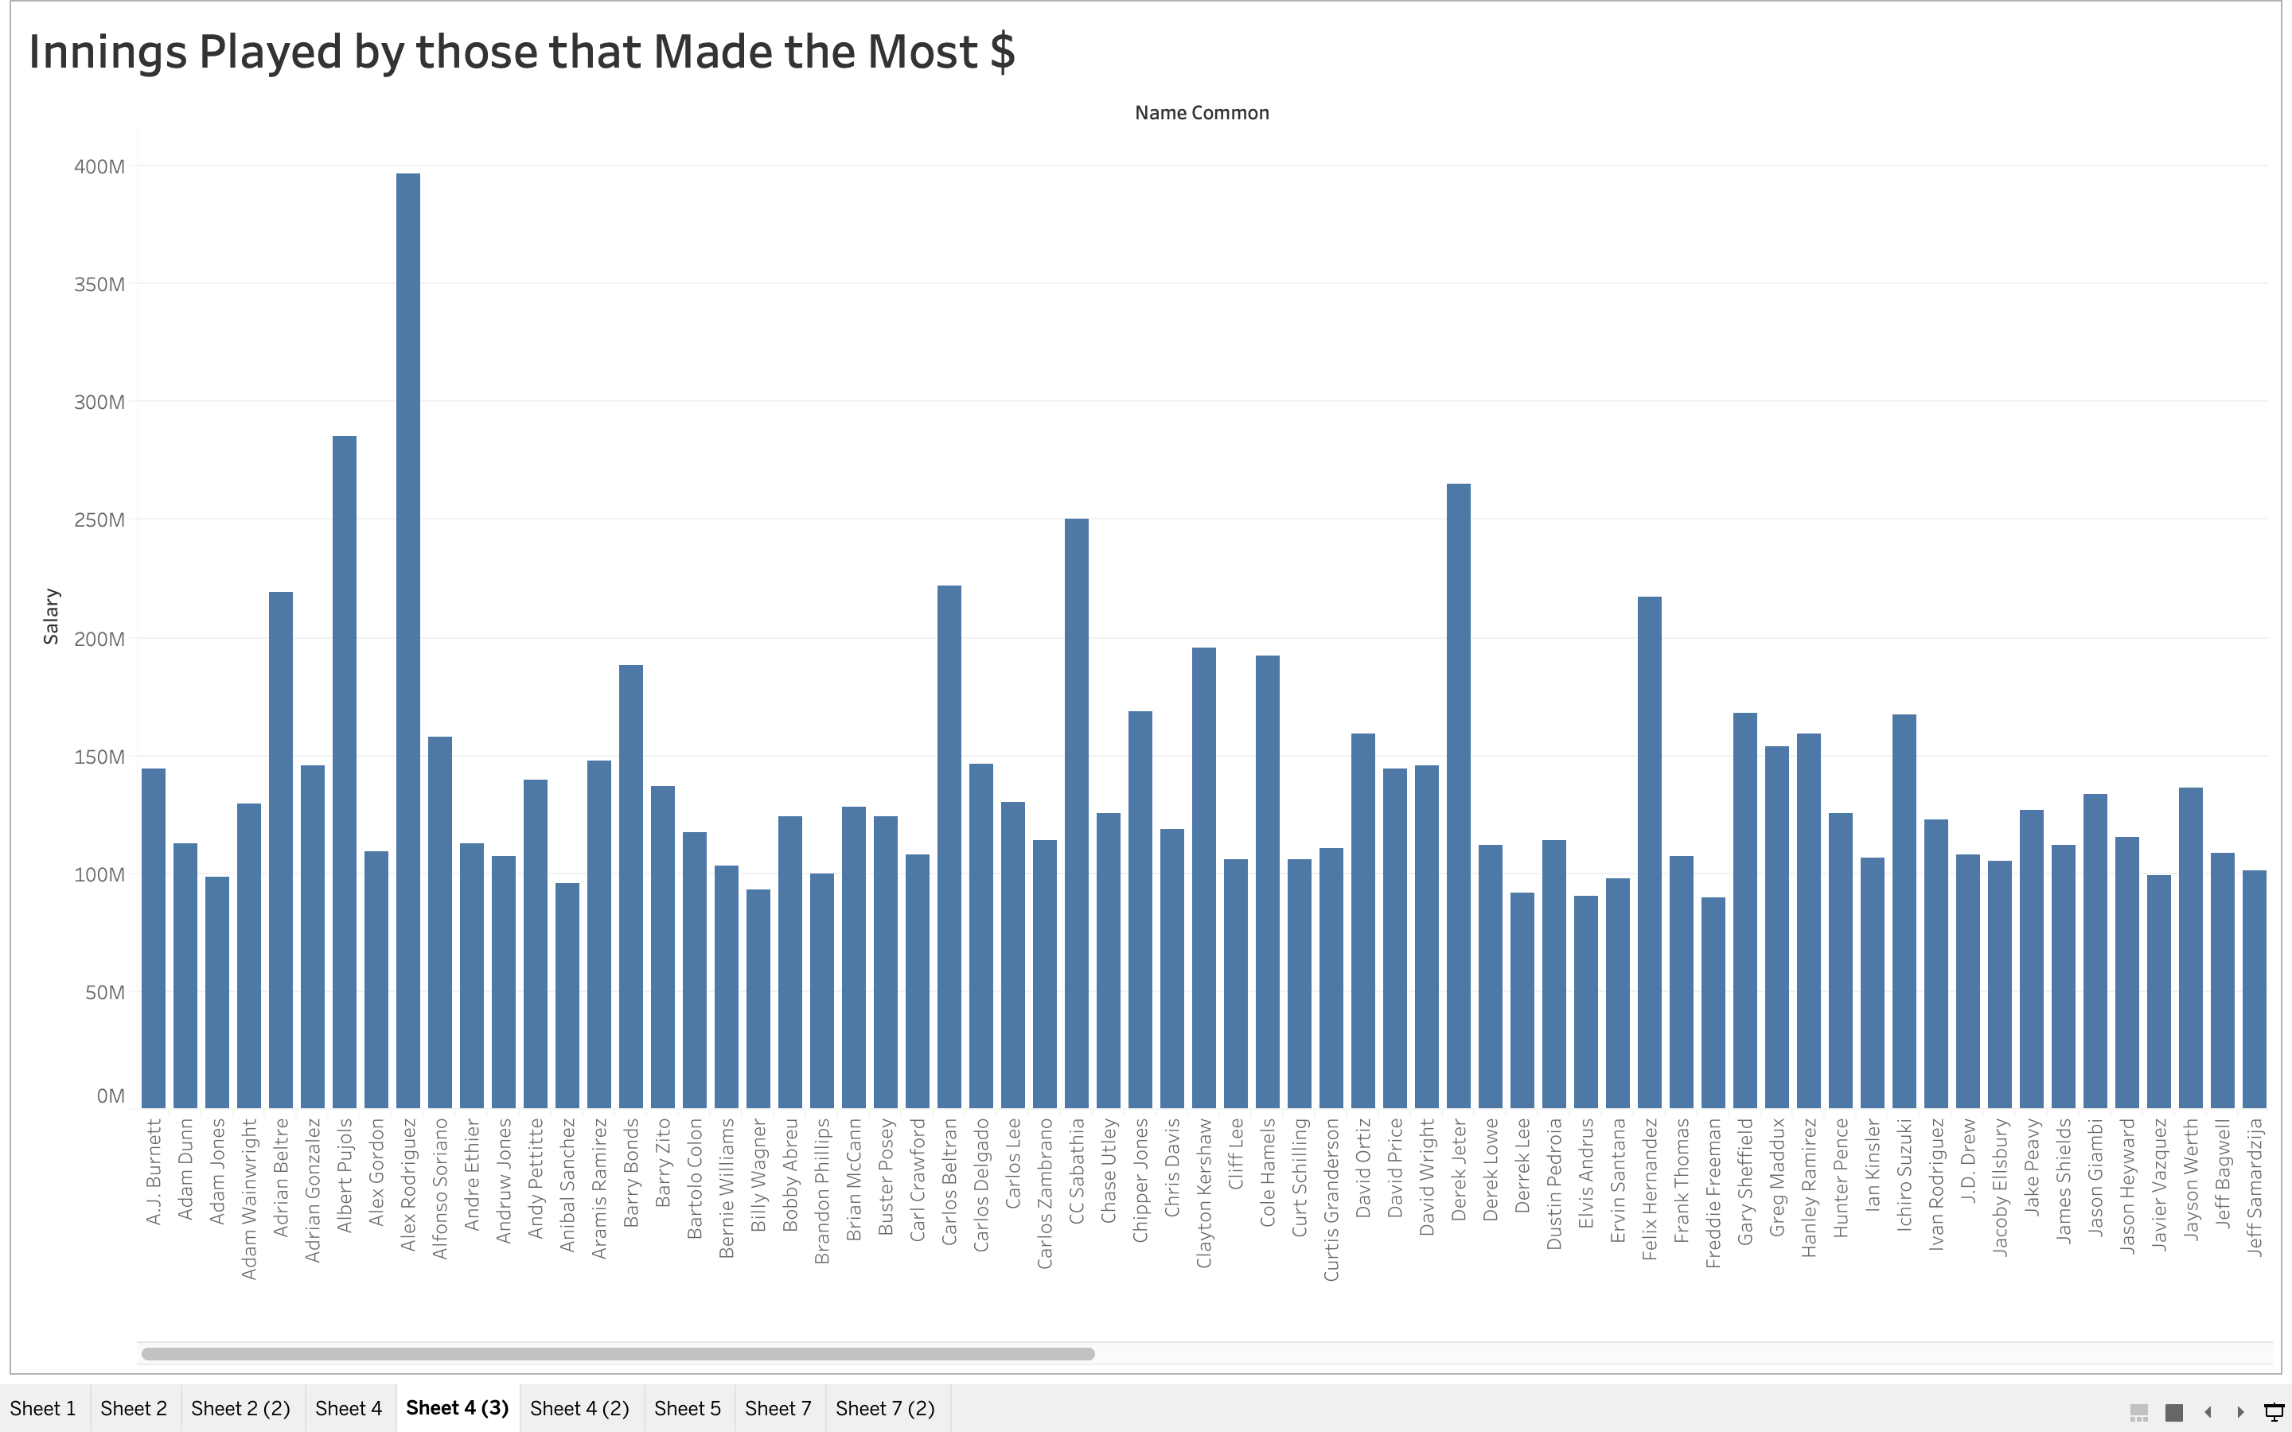

Slide 29
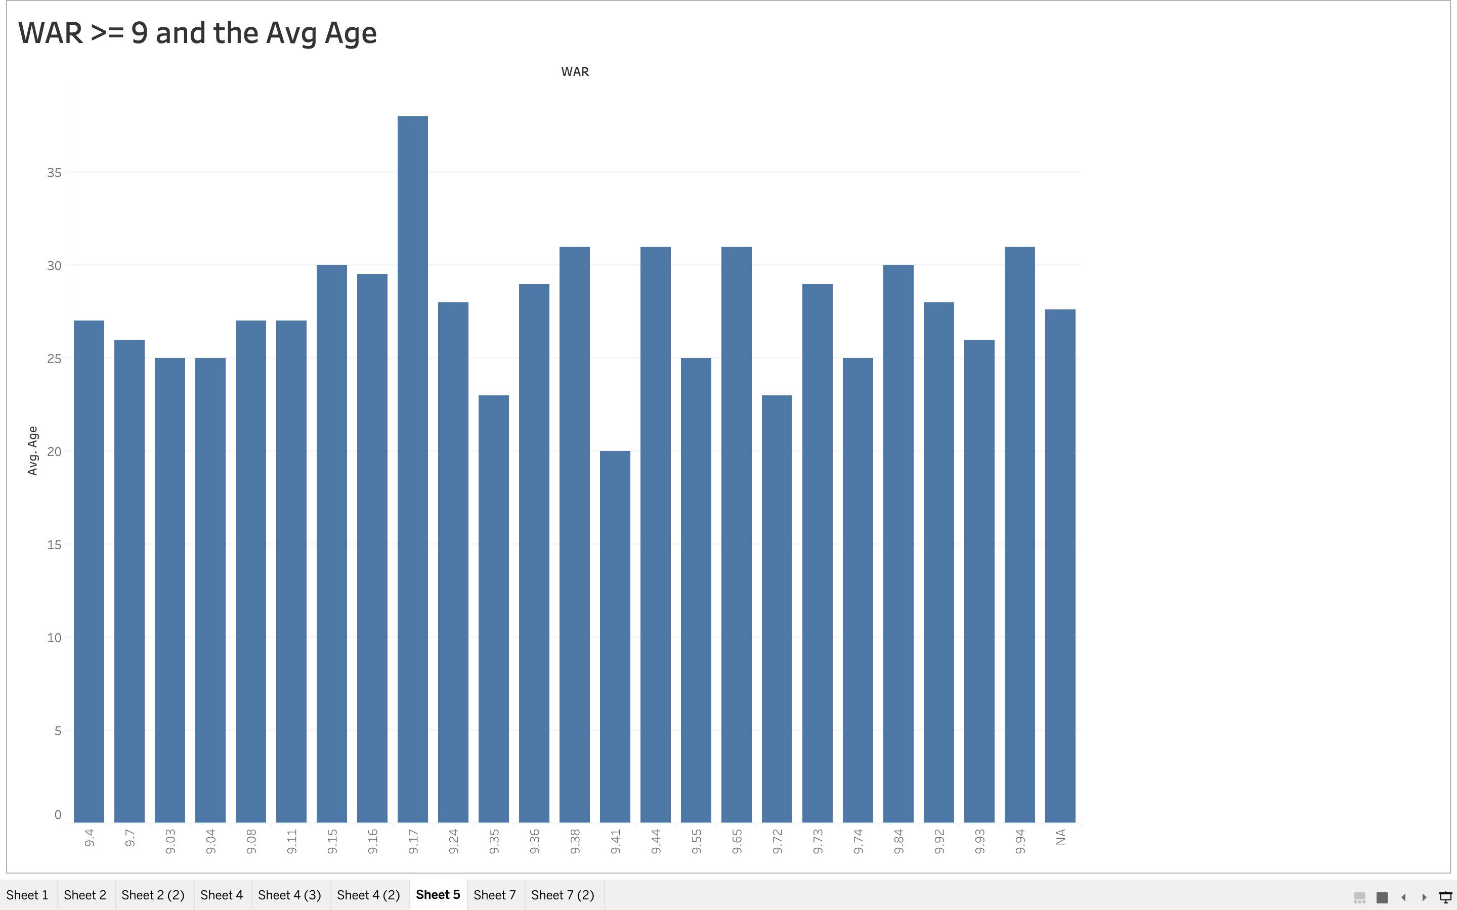
It might make more sense to put age on x-axis; also, chart should be in “entire view”

Slide 30
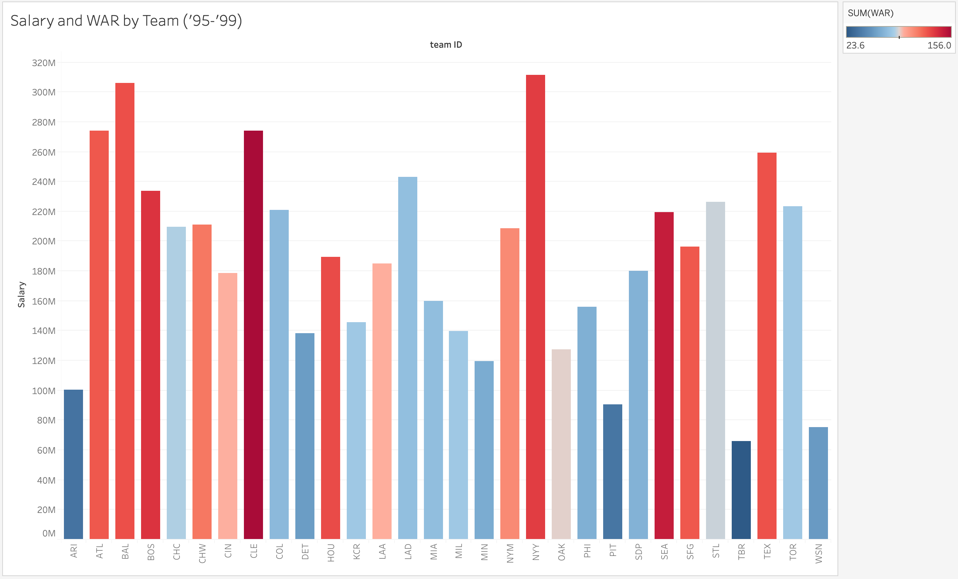

Slide 31
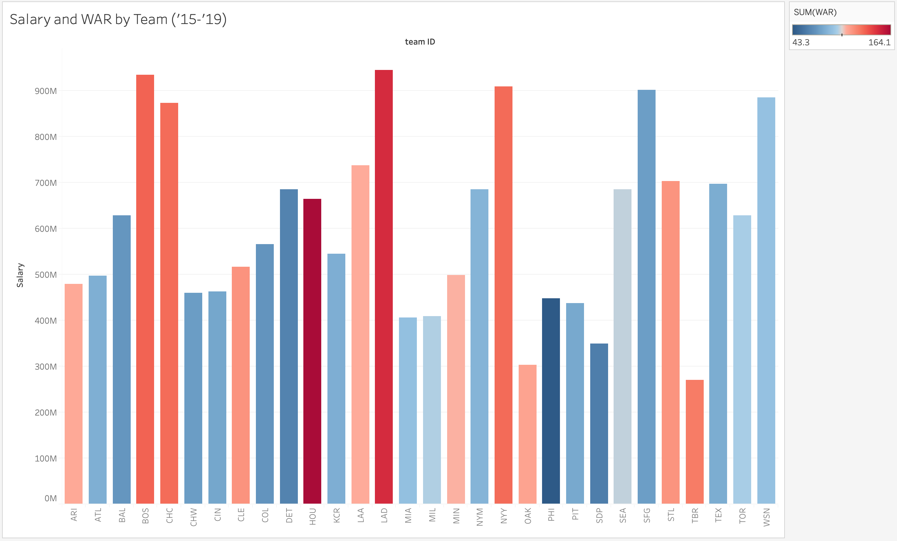

Slide 32
Summary
Teams are paying out higher salaries, but the average player is still not making the amounts they should based on their on-field play
Time and opportunities dictate a players earning power more than any other variable
One single season (or even a couple great seasons) will not necessarily mean a huge payday for a given player
Only consistently good play over time will have a significant impact on player salary

Slide 33
Conclusions
Based on the data and our knowledge of the sport, we were surprised by some of our results, specifically the lack of correlation with WAR
We would assume that there is more to this story
It’s difficult to definitively determined the cause of the significant change in salary over time which we identified
Further research could focus on collecting more data on player contracts to understand if their terms potentially caused a lack of immediate response in terms of salary to a players on the field play (confused by phrasing here?)

Slide 34
Thanks for your time Questions?

